Slide 1
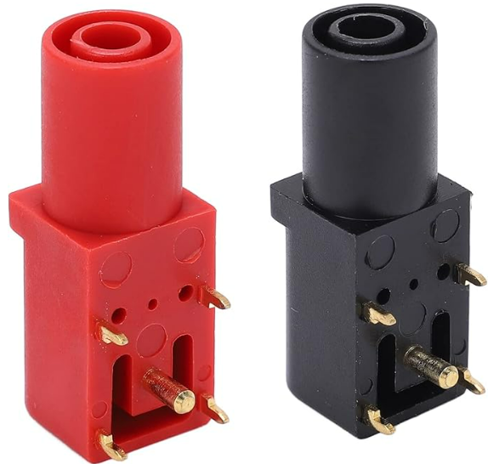
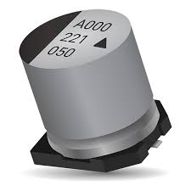
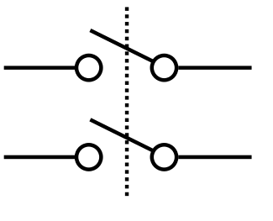
MAIN PWR
RELAY
±15V PWR
MONITOR
INRUSH
LIMITER
BULK STORAGE
-15V INPUT
- LAB SUPPLY 1
-15V NOMINAL
-20V INRUSH CURRENT LIMITER
-20V SWITCHED SUPPLY RAIL
+15V INPUT
+ LAB SUPPLY 2
+15V NOMINAL
+20V INRUSH CURRENT LIMITER
+20V SWITCHED SUPPLY RAIL
MAIN SUPPLY RAIL ENABLE
5V REGULATOR
800mA
5V SYSTEM PWR

Slide 2
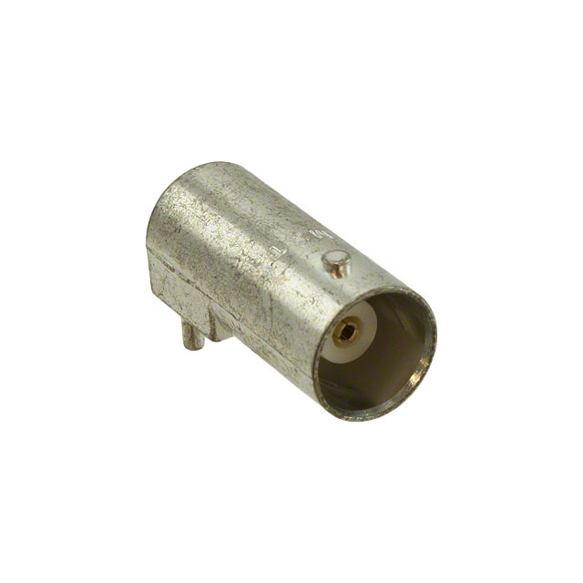
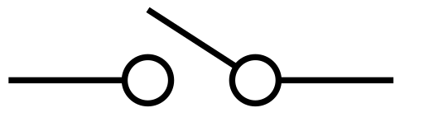
CH1 IN
INPUT Z
SWITCHED
50Ω / 1MΩ
Av = 1
DIGITAL
VOLTAGE
DIVIDER
Av = 1
Current
Boost
CURRENT
SENSE
OUTPUT
DISCONNECT
CH1 OUT
+15V MON
-15V MON
ADC ARB IN 1
I2C
ADC
ADC
UI INTERFACE MODULE
STM32F746G-DISCO
ADC – IMON 1
5V SYSTEM PWR
3.3V SYSTEM PWR
ADC – IMON 2
ADC ARB IN 2
I2C
INPUT Z
SWITCHED
50Ω / 1MΩ
Av = 1
DIGITAL
VOLTAGE
DIVIDER
Av = 1
Current
Boost
CURRENT
SENSE
OUTPUT
DISCONNECT
CH2 IN
CH2 OUT

